Slide 1
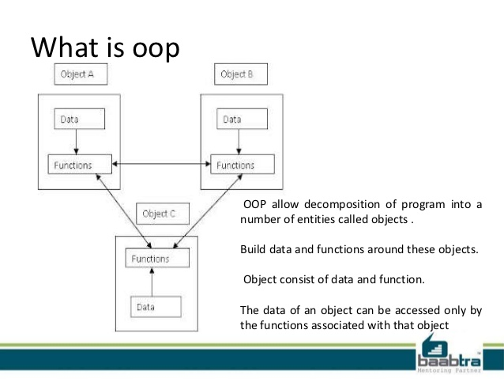
The Poop About Oop!

Slide 2
C# Tutor
Chapter7
Creating and Managing classes and objects
“Class” is the root word “Classification”
Design a Class—Systematically arrange information and behavior into a meaningful entity(act of classification)
Example: Car
Car is an object
All cars share common behaviors: drive/steer/stop
All cars share common attributes: steering wheel/engine
The word “car” is used to mean an “object” that shares these common behaviors and attributes.
Without classification, communication would be impossible.
Object oriented programming monopolizes on that concept and writes programs by:
1. “Classifying the different concepts inherent in a problem and its solution”
2. “modeling these classes in a programming language”
3. “Object-Oriented Programming Languages
4. C#

Slide 3
Encapsulation
A program that uses a class, should NOT have to define how that class works internally.
The program simply creates an instance of that class and calls the methods of that class
.
THE MAGIC INSIDE THE MACHINE..AS LONG AS IT WORKS..WHO CARES!!!
The internal state information and the finite details are hidden from the program..
LIKE THE INSIDE OF YOUR CELLPHONE! THE INNER SECRETS OF YOUR CELL PHONE ARE
ENCAPSULATED WITHIN CASE.
Called: Information Hiding
Purposes:
To combine methods and data within a class; in other words, to support classification
to control the accessibility of the methods and data; in other words, to control the use of the class
Defining and using a class
Keyword: “class” is used to define a class
Class has a body and the methods and data are contained in that body
Enclosed in Curly Braces {}

Slide 4
Class
Example
class Circle
{
int radius;
double Area()
{
return Math.PI * radius * radius;
}
}
Class
data
method
Return statement
Class Scope/body
Body contains ordinary methods (Area) and
Fields (radius) : class variables are called fields

Slide 5
Class
A class is a definition of a type
A class is a reference type that is stored on the heap in memory
To create a new class, you must use the keyword new
The word new creates a new instance of the class commonly called an object
Example 1: create a new class, an instance of a class(object) using the new keyword
Circle c;
c = new Circle();
You CAN assign an instance of a class to another variable of the same type
You CANNOT assign literal class values to variables
Example 2: assign a class type to another class type
Circle C;
c = new Circle();
Circle d;
d = c;
Do not confuse the terms class and object. A class is the definition of a type. An object is an instance of that type.
Several different objects can be instances of the same class.

Slide 6
Controlling accessibility
Encapsulation creates a boundary to the outside world , all data and methods inside the body of the class are isolated/private
And cannot be used by the outside world.
Applying access modifiers is necessary at this point.
Private: Methods and data are only accessible within the class. Declare using the word private, placed before the declaration.
the private access modifiers is the default if no access modifier is explicitly defined.
Example:
private int radius;
Public: Methods and data are accessible within and from outside the class. Declare using the word public, placed before
the declaration.
Example:
public double Area()
Rule of thumb: Identifiers that are public start with a Capital letter: public double Area()
Identifiers that are private start with a lowercase letter: private int radius
Known as camelCase
Exception: Class names should start with a Capital letter, and constructors must match the name of their class exactly
**note** do not declare two public class members that only differ in case, creates problems with language interoperability.

Slide 7
Working with constructors
When an instance of a class is created using the new keyword,
The Runtime needs to construct that object by using the definition of the Class.
The Runtime grabs a piece of memory from the operating system, fills it with the fields defined by the class
The Runtime invokes a constructor to perform any initialization required.
Constructor
Special method that runs automatically when you create an instance of a class
Same name as the class
Takes parameters
Cannot return a value
Every class must have one
The compiler will write a default one if you don’t
Example:
Class Circle
{
private int radius;
public Circle()
……..
}
If the public access modifier is left off, the constructor becomes private by default and cannot be used outside the class
And you cannot create Circle Objects from methods that are not part of the Circle class.
Constructor!!

Slide 8
Overloaded constructors
A constructor is a method and like other methods it can be overloaded
In order to initialize private fields that were initialized to 0 by the default constructor
A second constructor can be added as an overloaded constructor and the private fields can be initialized as parameters within
The overloaded constructor
If you write your own constructor, the compiler does not write a default constructor but you can add one yourself.
Example
Class Circle
{
Private int radius;
Public Circle()
{
radius = 0;
}
Public Circle(int initialRadius)
{
radius = initialRadius;
}
…………………….
Remember: Overloaded means there is more than one method with the same signature in the same scope,
Identified by the compiler by the parameters
Overloaded Constructor!!

Slide 9
Partial classes
A highly functional class can become very large.
In C# you can split the source code into separate files
To organize the definitions of a large class into smaller pieces that are easier to manage
Feature used by Visual Studio 2015 for Universal Windows Platform (UWP) apps.
Source code that can be edited is contained in separate files from the code that is generated by Visual Studio
Whenever the layout of a form changes
Splitting across multiple files
define the parts of the class by using the “partial” keyword in each file.
Example:
Circle class is split between two files
cir1.cs(containing the constructors)
cir2.cs(containing the methods and fields)
partial class Circle
When you split a class that has been split into separate files, you must provide all the files to the compiler

Slide 10
Understanding static methods and data
Not all methods naturally belong to an instance of a class
There are utility methods that provide useful functions that are independent of a class instance
“WriteLine” or “ReadLine” for example.
The Math class contains many utility methods for instance: Sin, Cos, Tan, Log, Sqrt.
If a method or a field is declared as “static” you can access the field or call the method by using the name of the class.
No instance is required.
double d = Math.Sqrt(42.24);
A static method does not depend on an instance of a class, it cannot access any instance fields or instance methods
Defined in a the class. It can only use fields and methods that are marked “static”.
Method is Sqrt and its class is Math,
the method is called using the name of the class

Slide 11
Creating a shared field
a static field can be shared among all objects created from a single class
Where nonstatic fields are limited to the scope of the instance object.
class Circle
{
Private int radius;
Public static int NumCircles = 0;
……….
Note: keep in mind that static methods are also called class methods. However, static fields are not usually
Called class fields; they are just called static fields or static variables.
Creating a static field by using the const keyword
Prefix the field with the keyword “const” , declares it as static without the static keyword. The value can never be changed.
“const” is short for “constant”. A field can only be “const” if it is a numeric type(int, double, ect), string or enumeration.
Public const double PI = 314159265358979
The class field “NumCircles” is marked as static
All circle objects can share this static field
It can be used inside and outside the class
By specifying the Circle class:
Console.WriteLine($”Number of Circle Objects: {Circle.NumCircles}”)’

Slide 12
Understanding static classes
Declare a class as “static”
can contain only “static” members
All objects you create by using this class with share these members
Static class acts as a holder for utility fields(Math Class)
You cannot use the new keyword to create an instance object of a static class
A static class can not hold any instance members
You can use a constructor to initialize members but it also must be static
public static class Math
Static using statements
When you call a static method or reference a static field, you must specify the class to which the method or field belongs,
Such as Math.Sqrt or Console.WriteLine.
Static “using” statements enable you to bring a class into scope and omit the class name when accessing static members.
Using static System.Math
Var root = Sqrt(99.9);
**Although this simplifies code, it could be problematic later when another programmer is sorting out your code.
By adding the System.Math using statement
You no longer have to reference the method “Sqrt” by
Referencing its class as such, Math.Sqrt()
You simple write Sqrt()’

